Slide 1


Slide 2
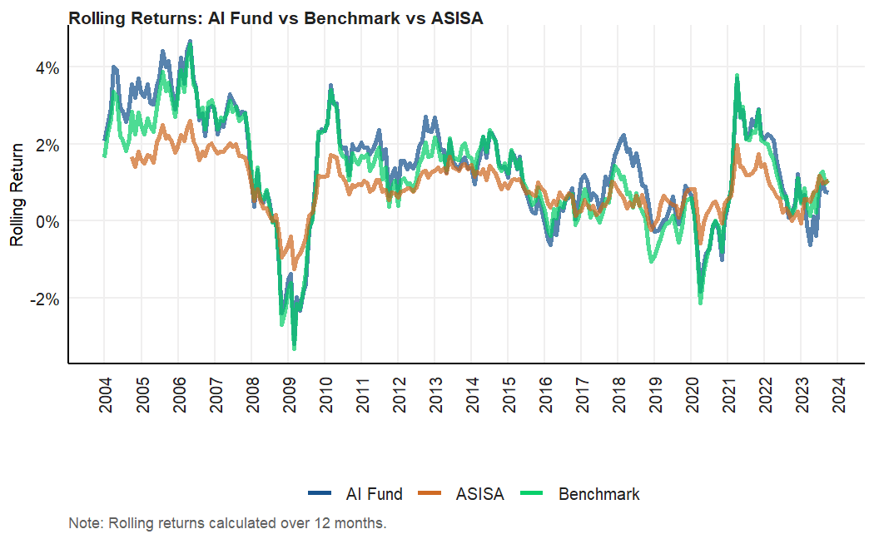
Rolling returns comparison

Slide 3
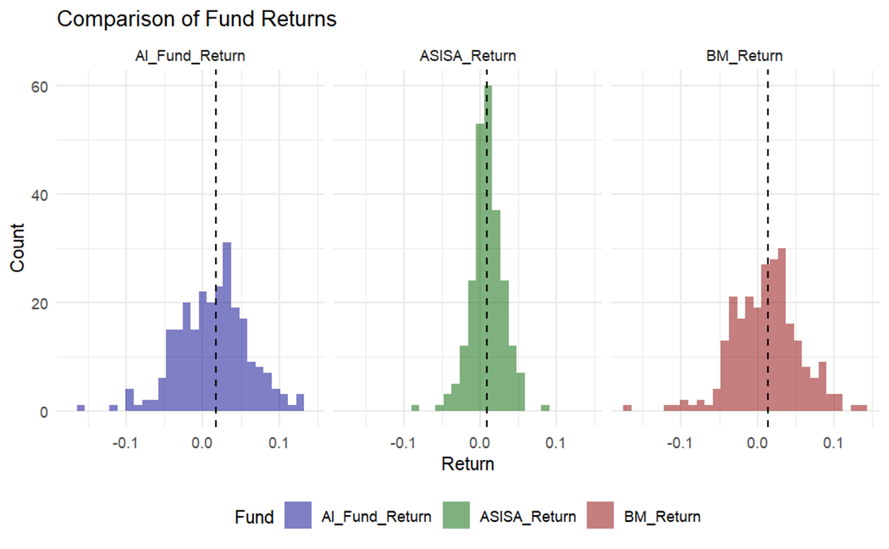
Box-plot comparison of returns

Slide 4
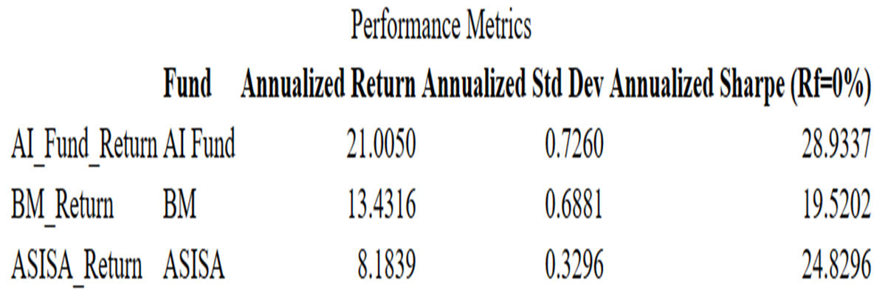
Performance metrics

